Slide 1
DSCI-531: FAIRNESS IN ARTIFICIAL INTELLIGENCE BIAS IN DATA
Keith Burghardt
February 5, 2024

Slide 2

Social data is heterogeneous
generated by individuals with different characteristics and behaviors

Slide 3

Social data is non-representative
individuals self-select on different platforms or for different behaviors

Slide 4

Social data is sampled
only a (possibly) biased subset of data is observed

Slide 5

Biases in data pose threats to the validity of learned models
Threats to Prediction
Models are non-generalizable and non-reproducible
Poor performance on held-out data
Threats to Explanation
Ecological fallacy
Misleading or wrong inferences about individuals
Impact on interventions
Threats to Fairness
Models learned on biased data may entrench and amplify discrimination
Notes:
Ecological fallacy: A failure in reasoning that arises when an inference is made about an individual based on aggregate data for a group.

Slide 6
Thought Experiment: At what temperature do people like their coffee?
203F
Measure the temperature of coffee of people walking by
137.1F after 10 measurements
Ecological fallacy
A failure in reasoning that arises when an inference is made about an individual based on aggregate data for a group.
195F
200F
68F
35F
198F
198F
194F
38F
42F

Slide 7
Thought Experiment: At what temperature do people like their coffee?
203F
Measure the temperature of coffee of people walking by
137.1F after 10 measurements
Ecological fallacy
Population is heterogeneous, composed of different groups
Subgroups have different features
Hispanics vs Whites
Subgroups represent cohorts of different age
Veterans vs novices
Different waves of data collection
Twitter sample in 2011 vs 2016
195F
200F
68F
35F
198F
198F
194F
38F
42F

Slide 8
Simpson’s paradox Subgroups with different behavior & population data | Selection bias Subgroups not equally represented | Berkson’s paradox Selection induces a trend where there is none
Sources of bias in heterogeneous data
Survivor bias Subgroup dropout induces population differences | Aggregation bias Different results and different temporal/spatial resolutions | Longitudinal fallacy Different ages of cohorts distort cross-sectional analysis
https://catalogofbias.org/biases/

Slide 9
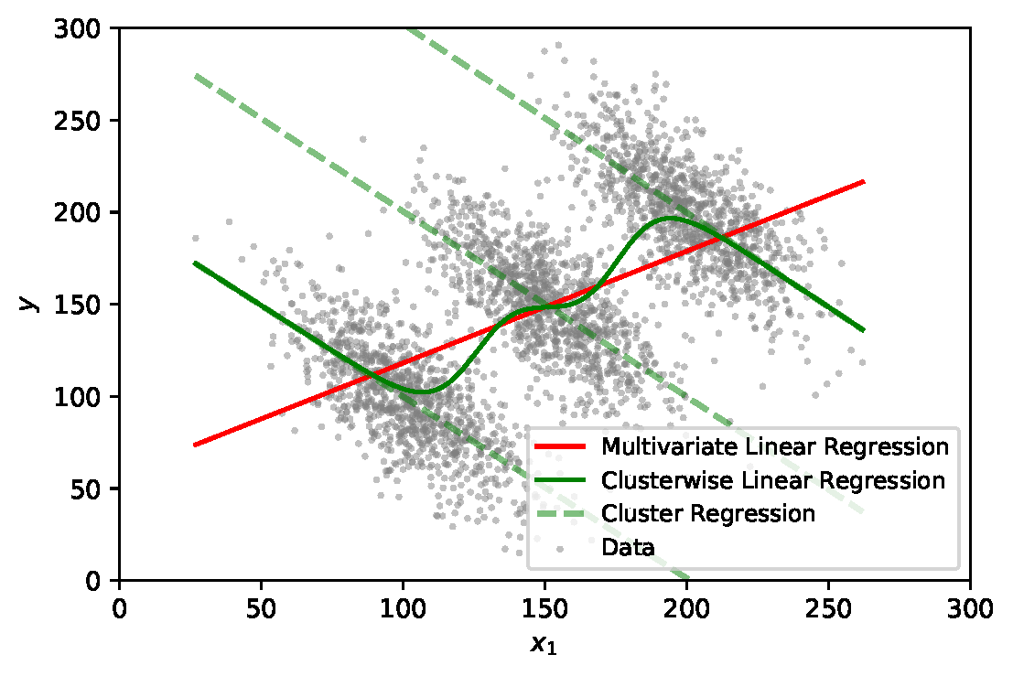
Simpson’s paradox
A trend appears in different sub-groups of data
but disappears or reverses when these sub-groups are combined.*
* Simpson (1951). "The Interpretation of Interaction in Contingency Tables" JRSS

Slide 10
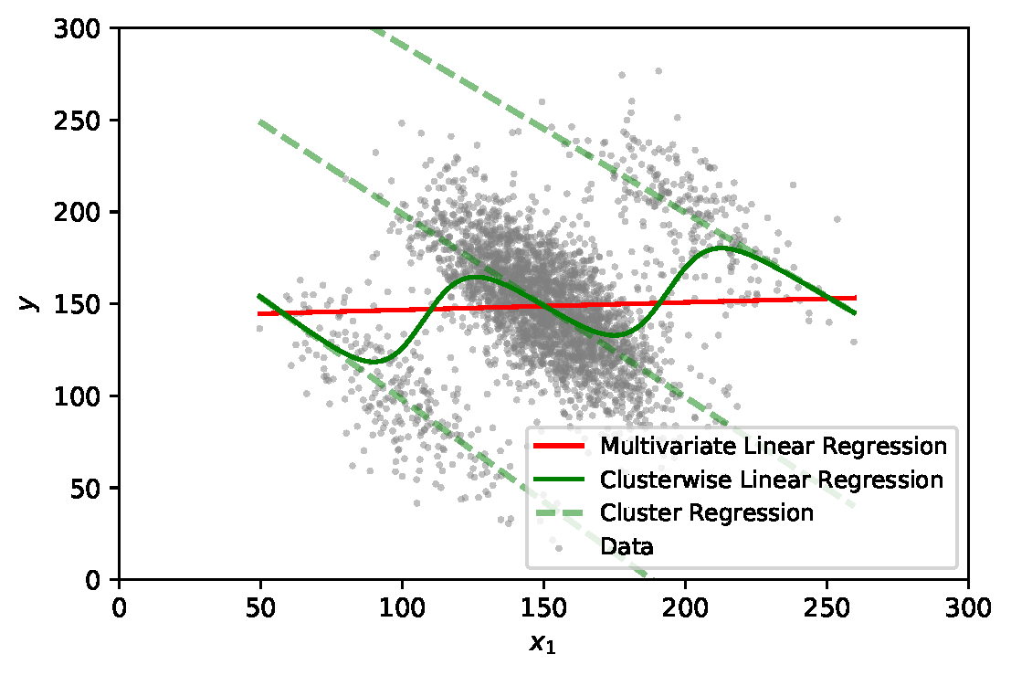
Sampling bias
Subgroups uniformly represented in population
Subgroups overrepresented in the population

Slide 11
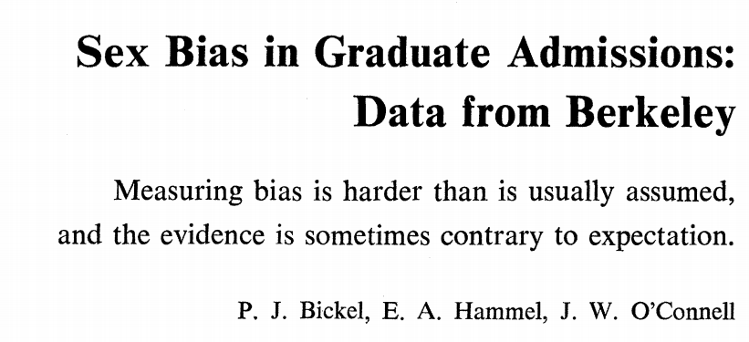
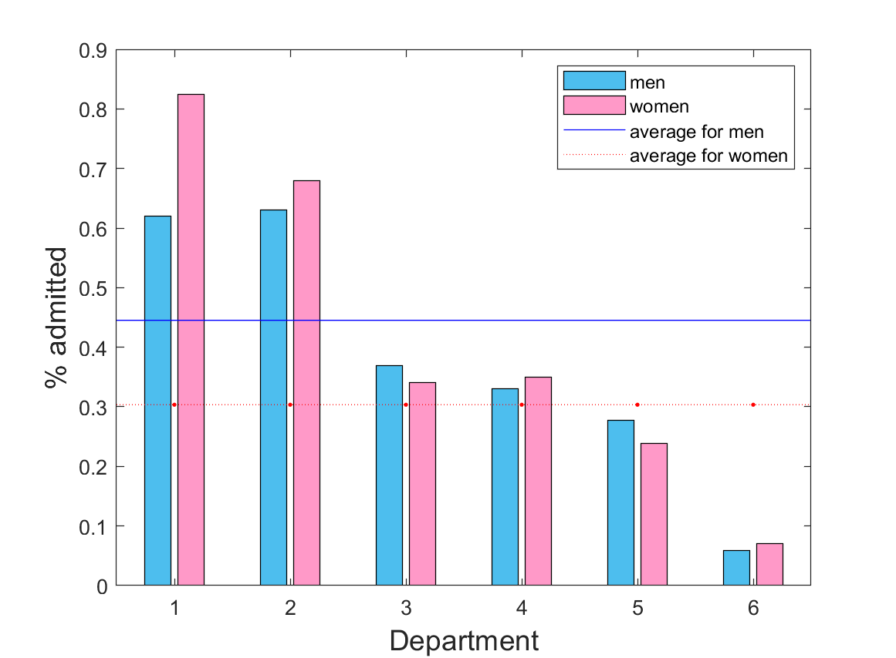
Admissions disaggregated by department
Source: Science, Vol. 187, No. 4175 (1975), pp. 398-404
43%
men
35%
women
Different population of applicants: more women apply to selective depts
Percent of applicants admitted for graduate study
Notes:
Simpson’s paradox is related to discrimination
General problem in data science – characteristics of population change with the independent variable

Slide 12
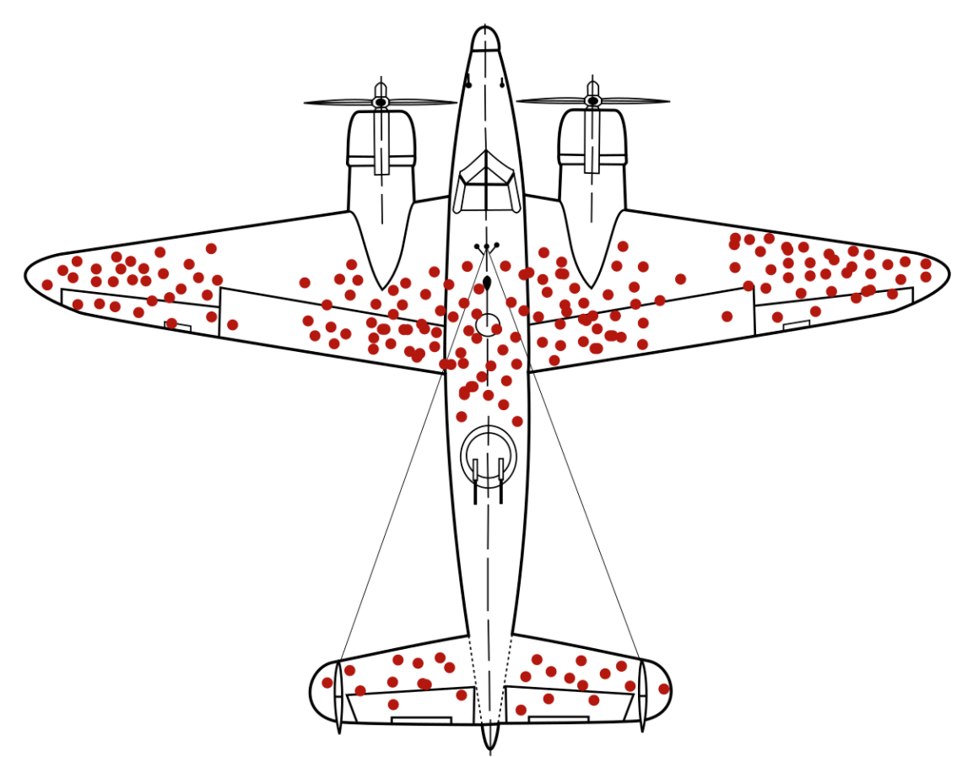
Survivor bias
WWII fighter planes coming in from battle had a distinctive pattern of damage from enemy guns
Where should you reinforce the plane to ensure it would not be shot down?

Slide 13
Survivor bias
[Vaupel, J. W. and Yashin, A. I. (1985). Heterogeneity's ruses: some surprising effects of selection on population dynamics. The American Statistician, 39(3):176-185.]
Mortality rate among aging cohort
Age: time since release from prison
Death: recidivism (commit another crime)
Cohort mortality rate is the weighted sum of the subgroup mortality rates, where the weights are the relative size of the subgroups
Cohort mortality rate does not tell you about the behavior of subgroups (or individuals)

Slide 14
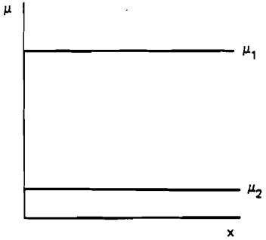
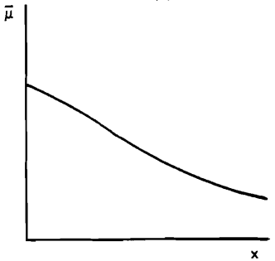
Survivor bias
Recidivism rate of convicts released from prison declines with age
In reality, two subgroups: incorrigibles and reformed. Over time, fewer incorrigibles in the population

Slide 15
Survivor bias
Recidivism rate of convicts released from prison declines with age
In reality, two subgroups: incorrigibles and reformed. Over time, fewer incorrigibles in the population

Slide 16
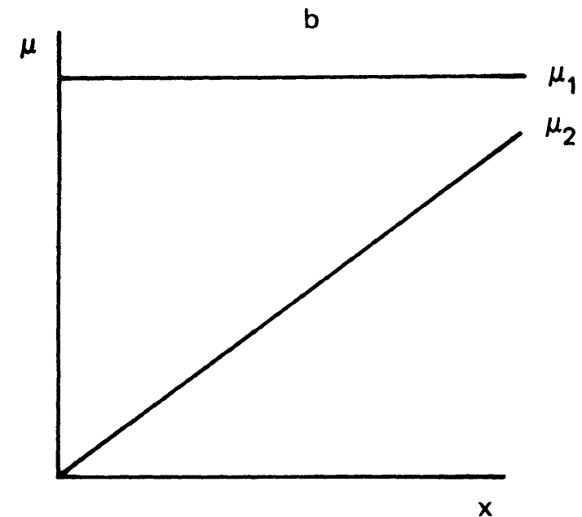
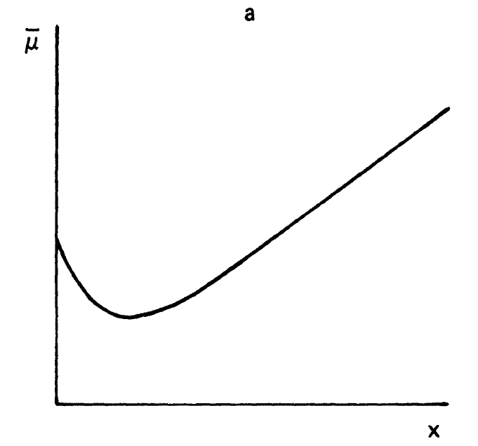
Does this cohort curve imply that the failure rate for a specific device decreases during the infant mortality phase ?
The high initial rate of breakdown could be due to a group of lemons (group 1).

Slide 17
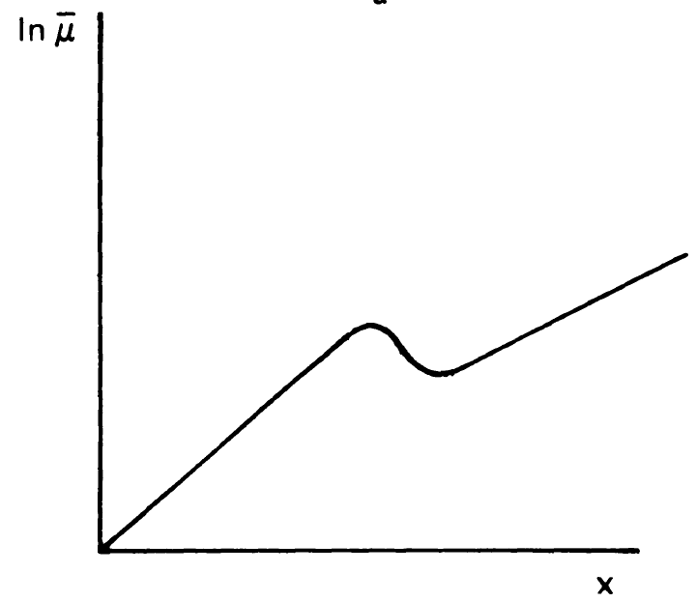
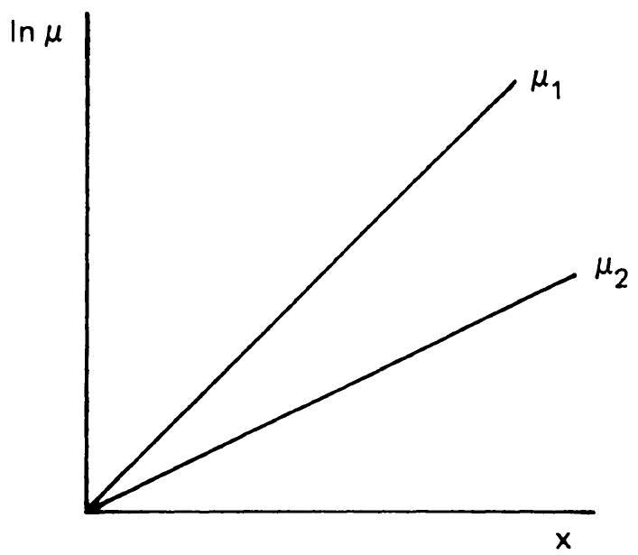
The sudden decline in the observed hazard rate is produced by the rapid extinction of the frailer subcohort (μ1).
Then, due to the exponential increase in mortality, the death rates become sufficiently large that within a few years almost all of the frailer subcohort dies

Slide 18
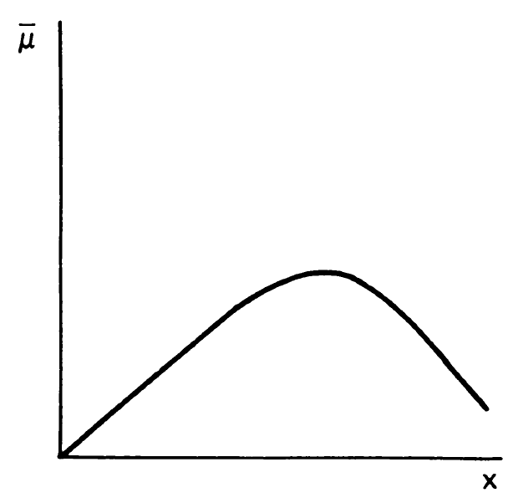
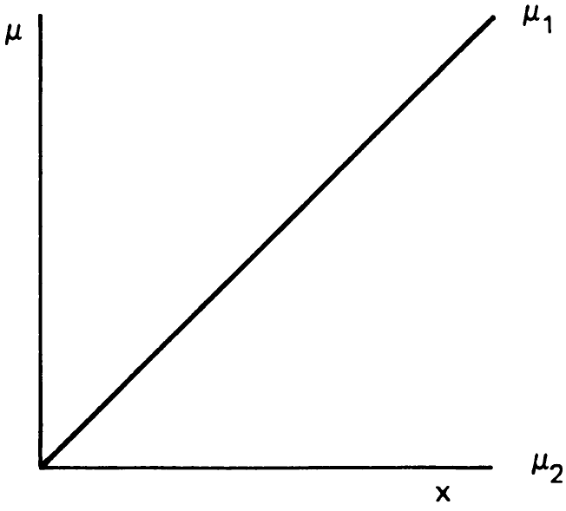
Observed mortality for the entire population may rise and then fall
E.g., divorce rates follow this pattern, but this does not imply that marriage is more likely to fail after the first few years. In reality, for one group marriage strengthens with duration, and for the other, it weakens

Slide 19

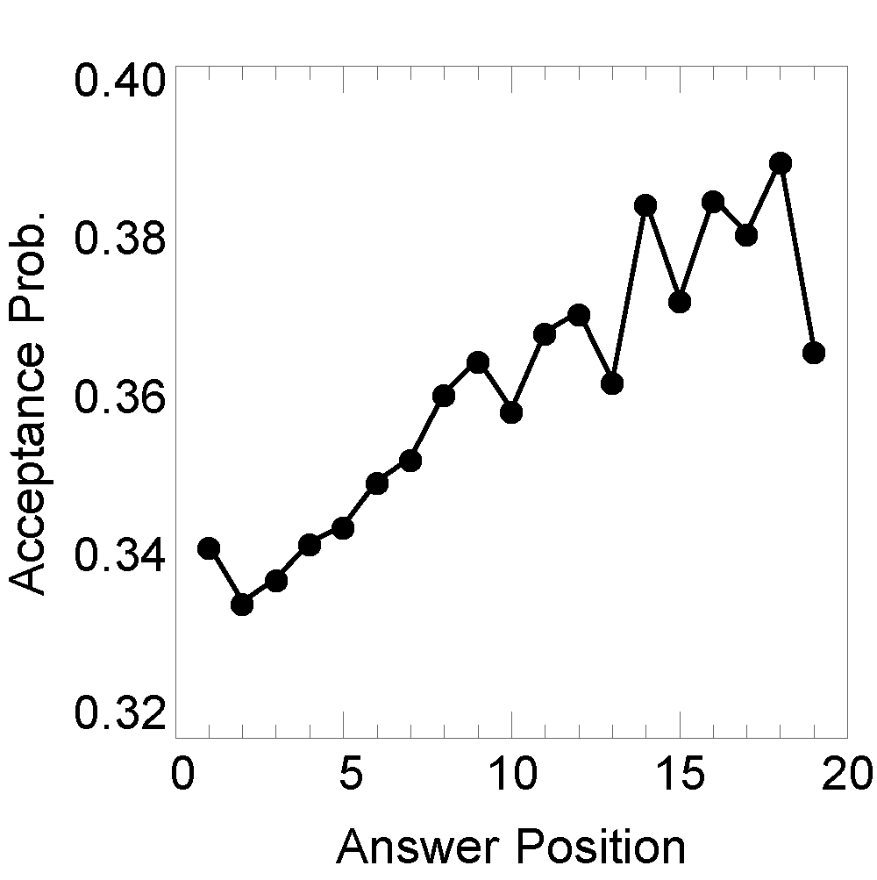
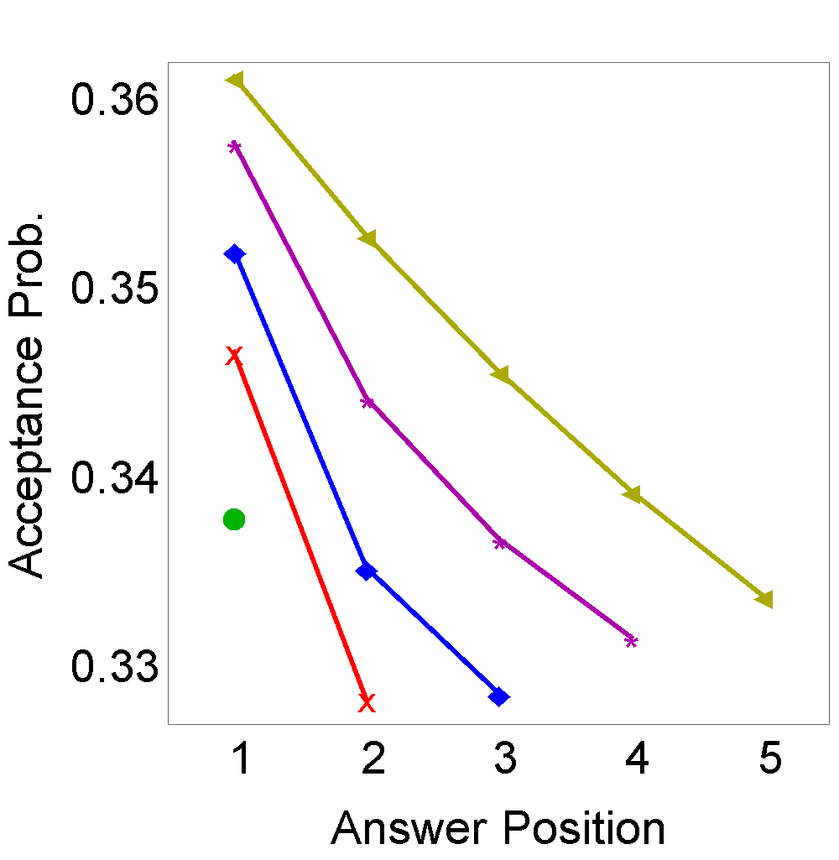
Survivor bias on
Every subsequent answer written by a user appears to be better (accepted as best answer) …
… when disaggregated by session length, every subsequent answer is worse
(cf “ego depletion”)
Alipourfard et al (2018) “Using Simpson’s paradox to discover interesting behavioral patterns in data” in ICWSM 2018

Slide 20
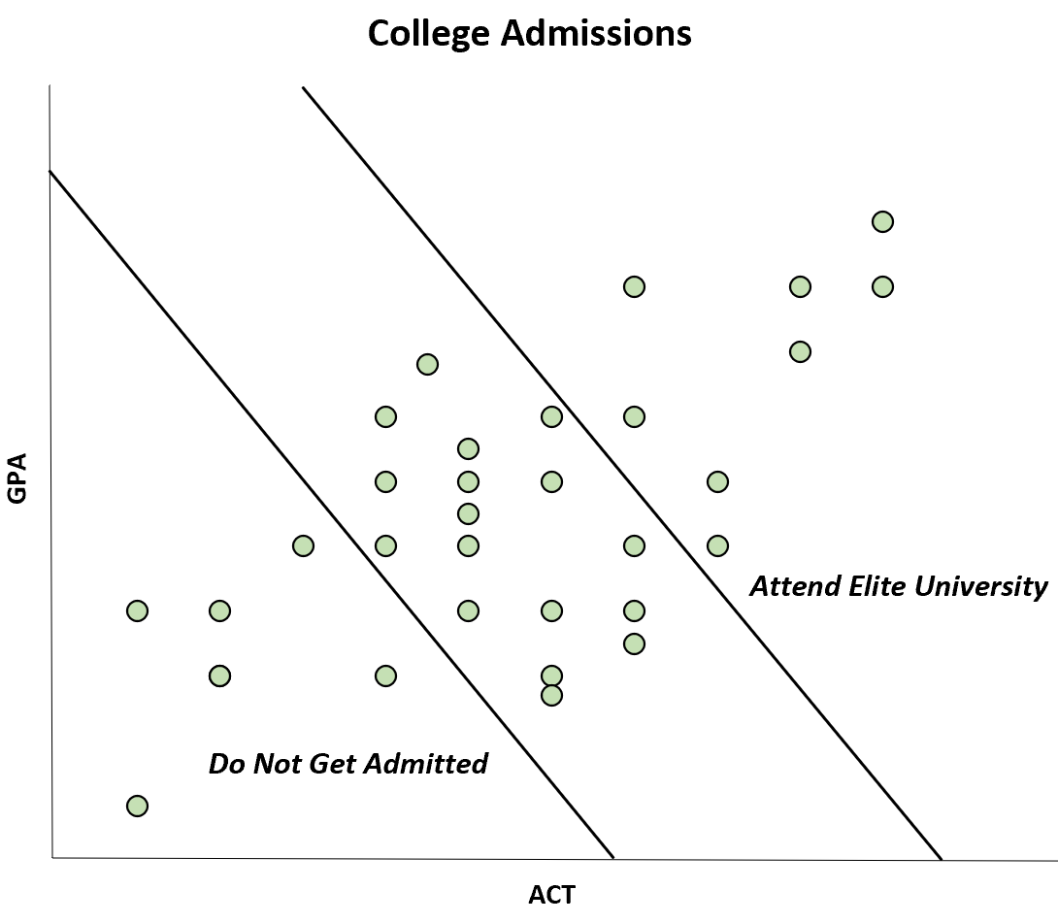
Berkson’s paradox
A positive correlation in a population can appear as negative correlation in a sample.
Illustration: College only admits students with high enough GPA or high enough ACT score.
GPA and ACT are correlated, but among the students who decide to go to a particular college, there appears to be a negative correlation between the two. Why?

Slide 21
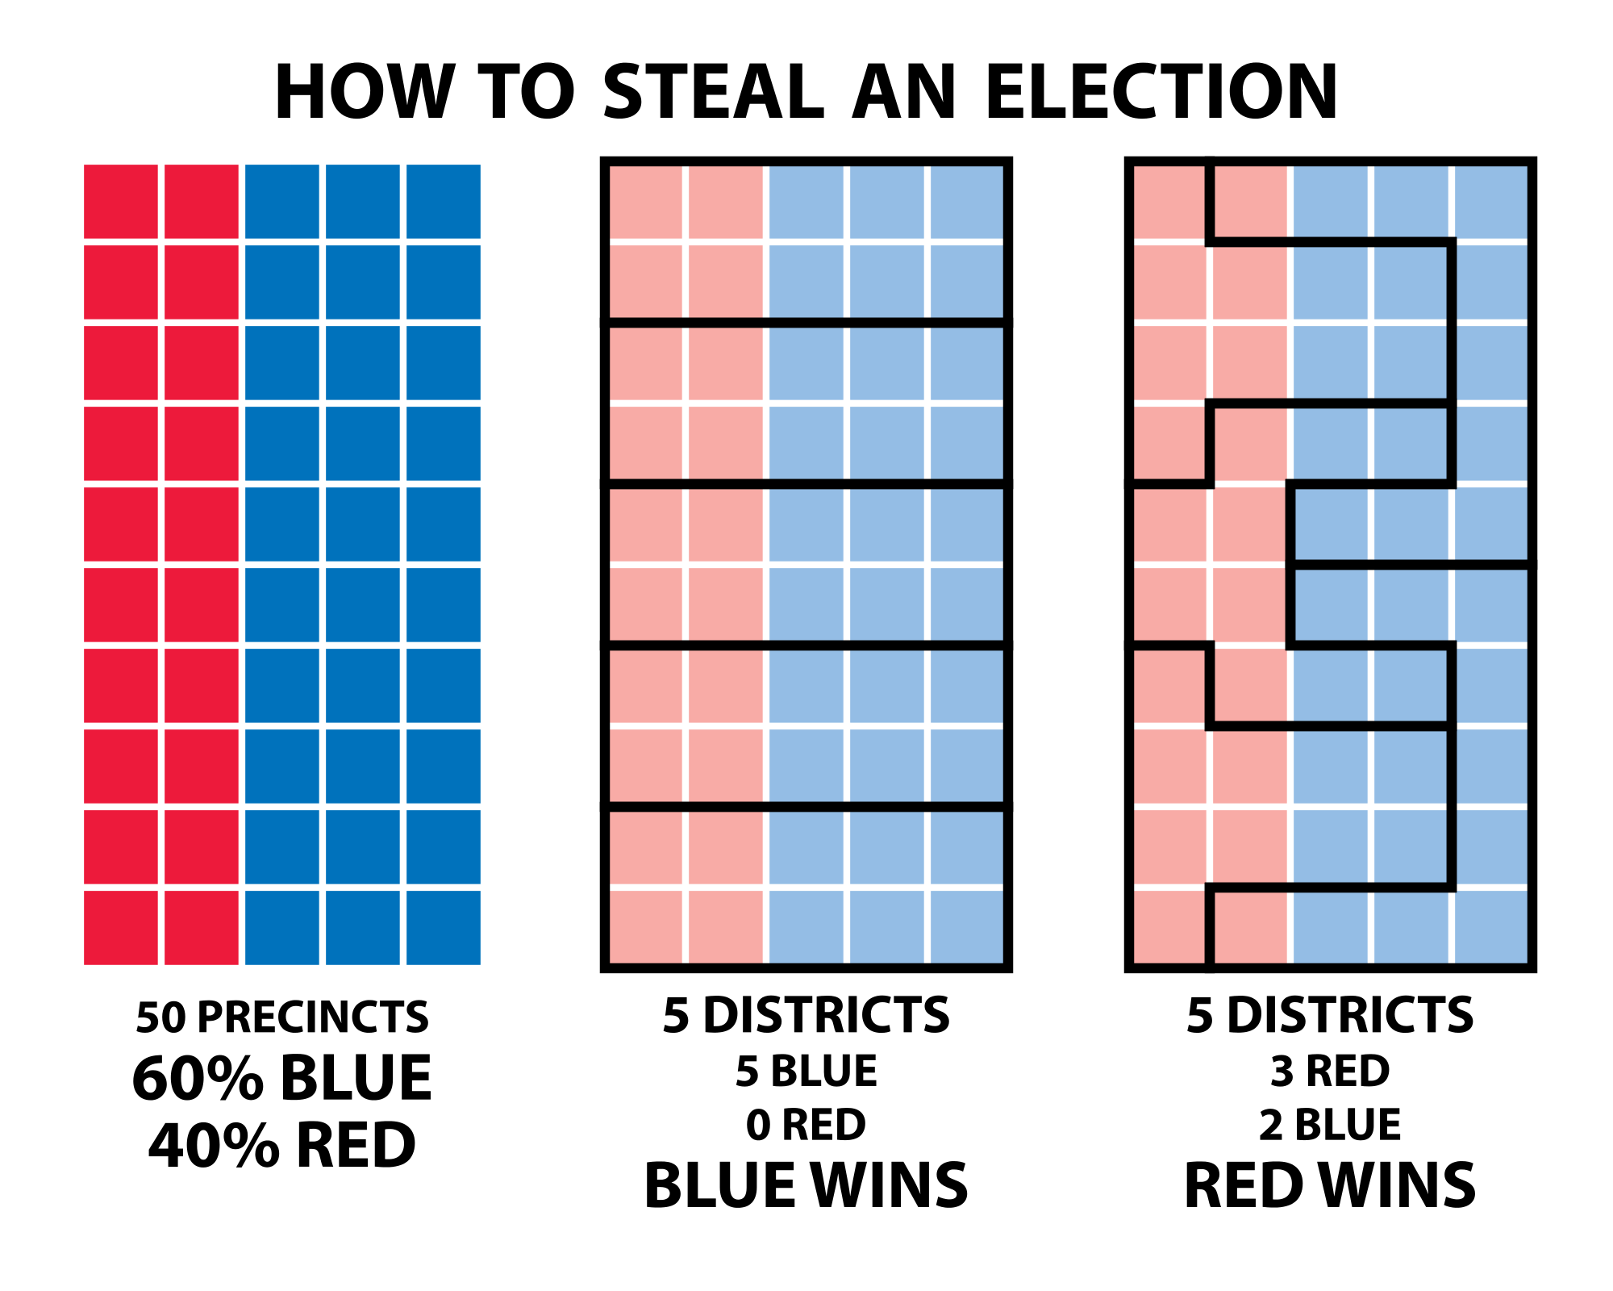
Aggregation bias
Modifiable areal unit problem (MAUP) is a statistical bias that affects results when data is aggregated. The resulting estimates (e.g., totals, rates, densities) are affected by both the shape and scale of the aggregation unit.

Slide 22
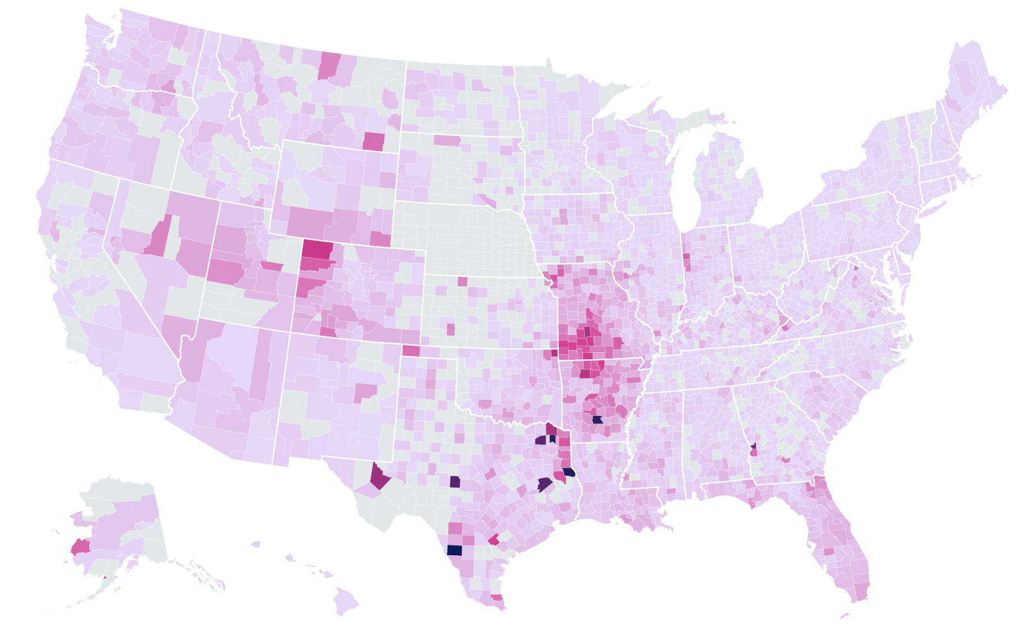
Aggregation bias
Modifiable areal unit problem (MAUP) is a statistical bias that affects results when data is aggregated. The resulting estimates (e.g., totals, rates, densities) are affected by both the shape and scale of the aggregation unit.

Slide 23
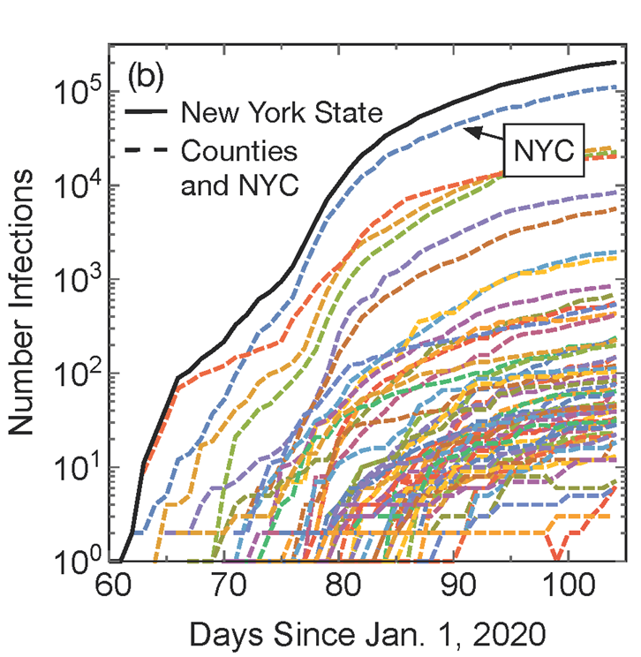
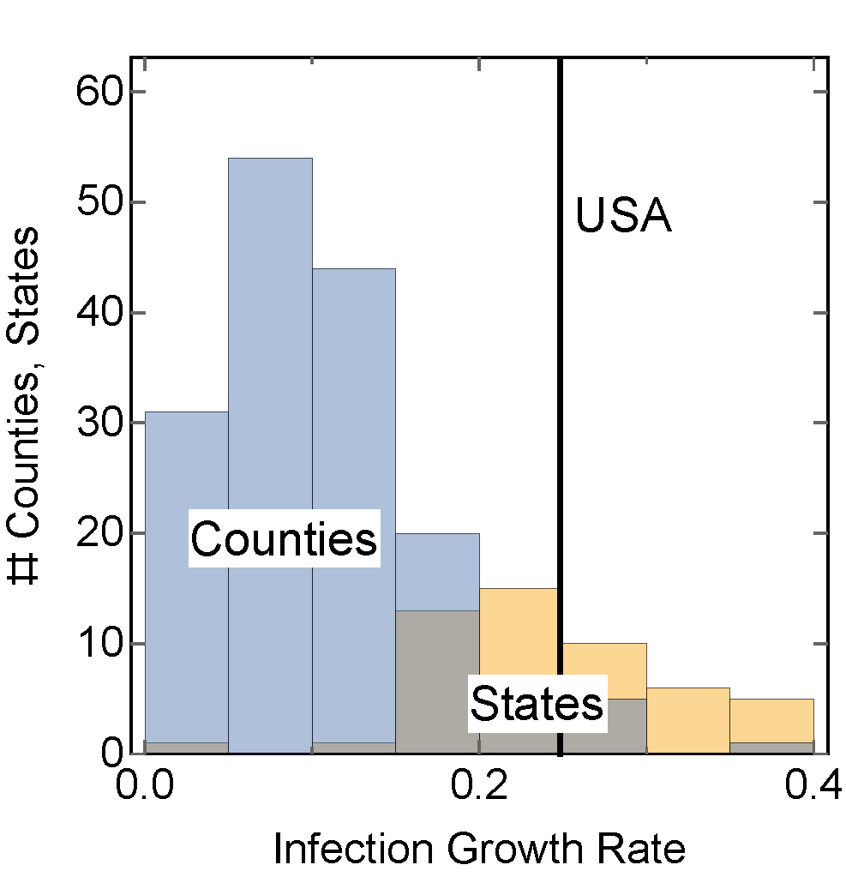
Aggregation bias
Growth rate of Covid-19 infections in US counties
… appears slower than when the same data is aggregated by state, or country
Burghardt, K., & Lerman, K. (2020). Systematic Biases in Aggregated COVID-19 Growth Rates. arXiv preprint arXiv:2004.12994.

Slide 24
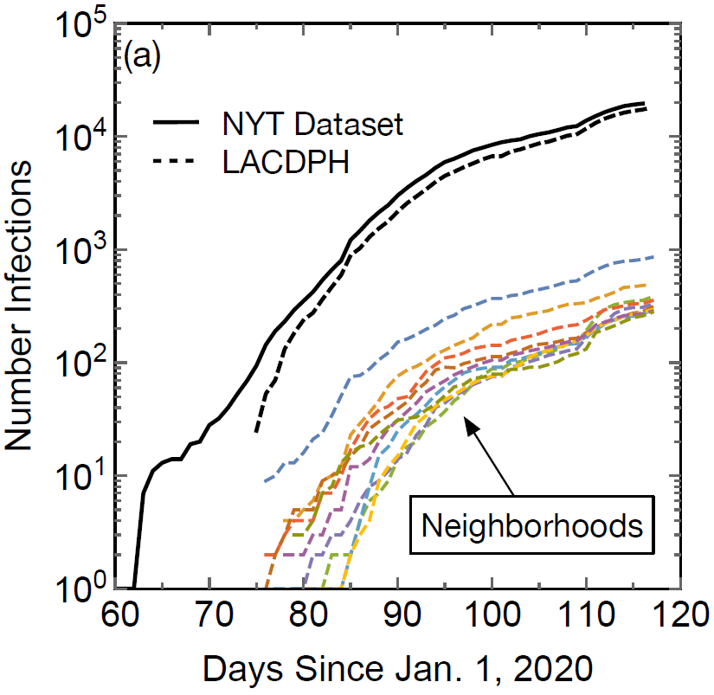
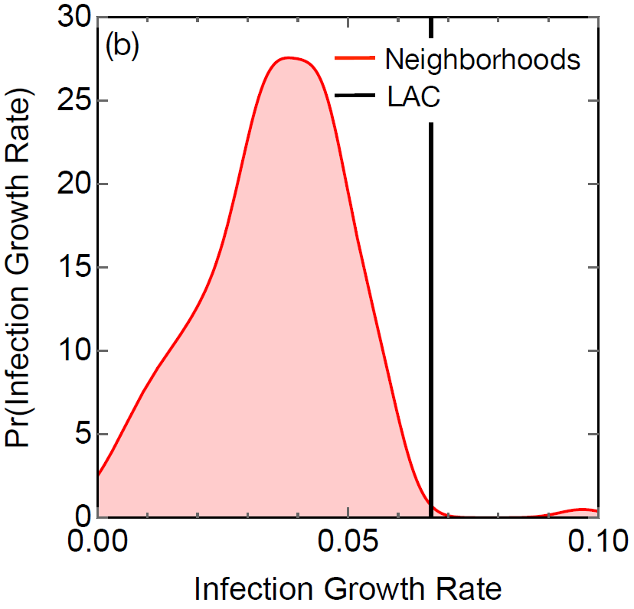
… also at the metropolitan level
… appear to spread faster than in neighborhoods
Infections in Los Angeles county

Slide 25
Analysis of temporal data
Understanding data/behavior that evolves over time
Cross-sectional analysis
Aggregate time-based analysis is a natural starting point
Approach: combine all available data about people (potentially over long periods of time)
This could be misleading and not describe any individual user
Why? Mixes old and new data
Longitudinal analysis
Follow the same group over time

Slide 26
Accounting for time – cohort analysis
Online communities are evolving continuously.
Tenure - How long a user has participated in the community
Join date - When the user join the community
Cohort analysis is a type of longitudinal analysis: A cohort is a group of people who share a characteristic, generally with respect to time
E.g., USC class of 2023, people born in 1990, etc.
Cohorts in online communities
E.g., Wikipedia users who joined in 2005

Slide 27
Longitudinal vs Cross-sectional
Longitudinal analysis gathers data repeatedly from the same cohorts.
A cohort is a group of people who share a common characteristic, generally with respect to time: E.g., people born in 1990, Reddit users who joined in 2010, etc.
Cross-sectional analysis aggregates data over all cohorts at a specific point in time.
Often cross-sectional studies are done as if they were longitudinal
cohort 1
cohort 2
cohort 3
time
cohort 1
cohort 2
cohort 3
time

Slide 28

Case study*: Is Reddit getting worse?
The data:
1.65 billion comments publicly available comments from October 2007 until May 2015
114 million submissions from October 2007 until December 2014
UTC creation date, the username, the subreddit, and for comments, the comment text
[Barbosa, S., Cosley, D., Sharma, A., & Cesar Jr, R. M. (2016, April). Averaging gone wrong: Using time-aware analyses to better understand behavior. In Proceedings of the 25th International Conference on World Wide Web (pp. 829-841). International World Wide Web Conferences Steering Committee.]

Slide 29
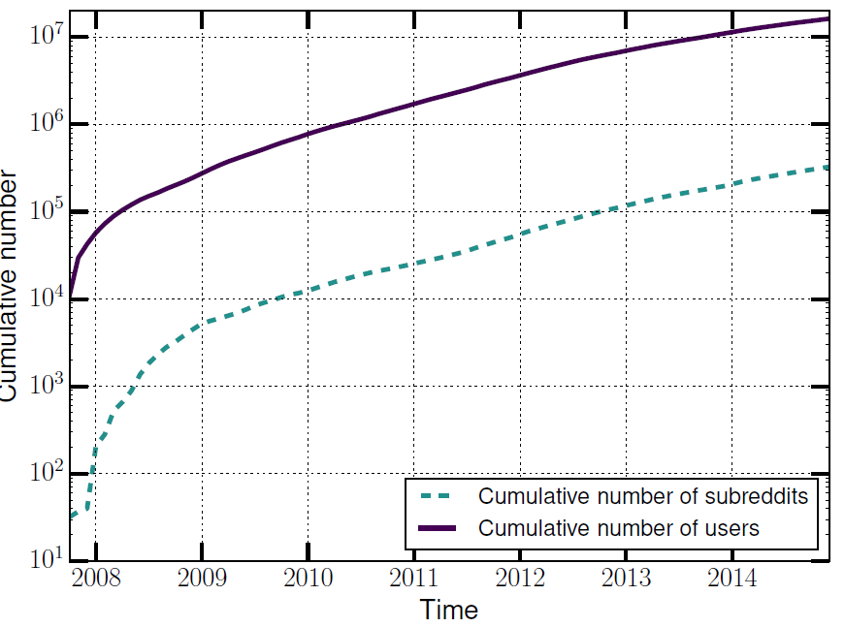
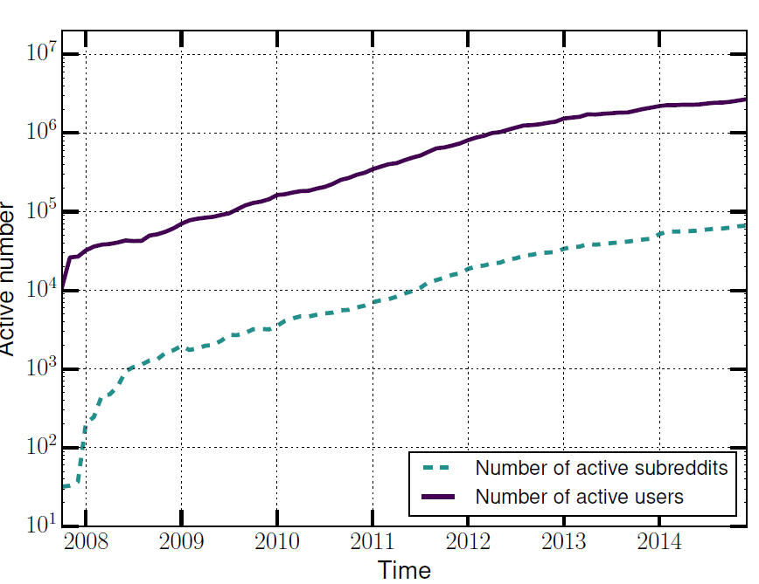
The size of Reddit
Cumulative number of users/subreddits
Number of active users/subreddits

Slide 30
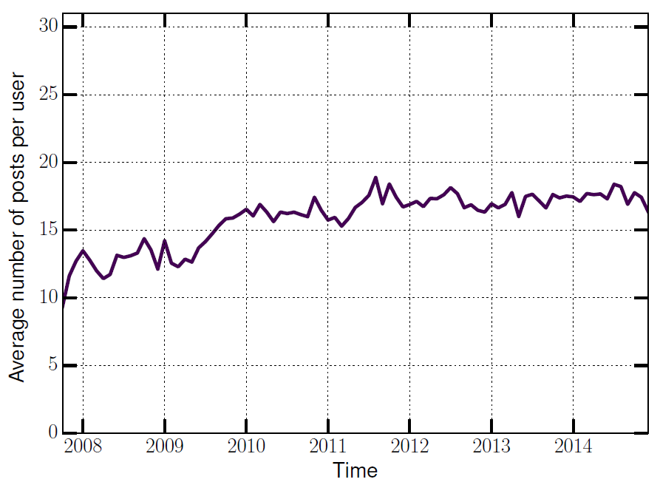
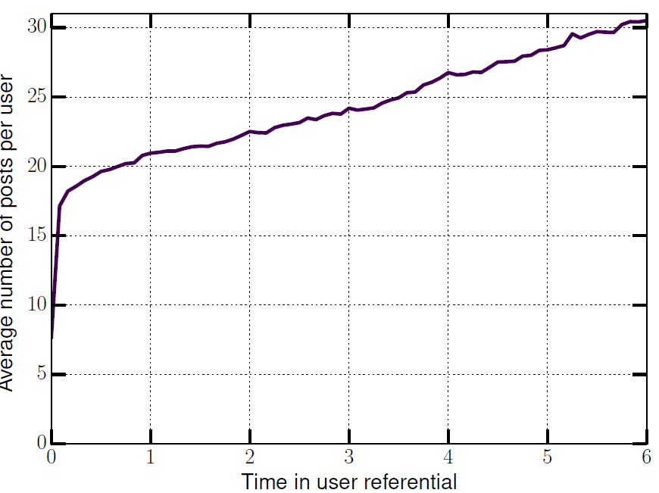
Activity over time
Activity over time:
Users may be becoming more active over time
Activity with respect to user tenure:
The longer the user survives the more s/he posts. …?

Slide 31
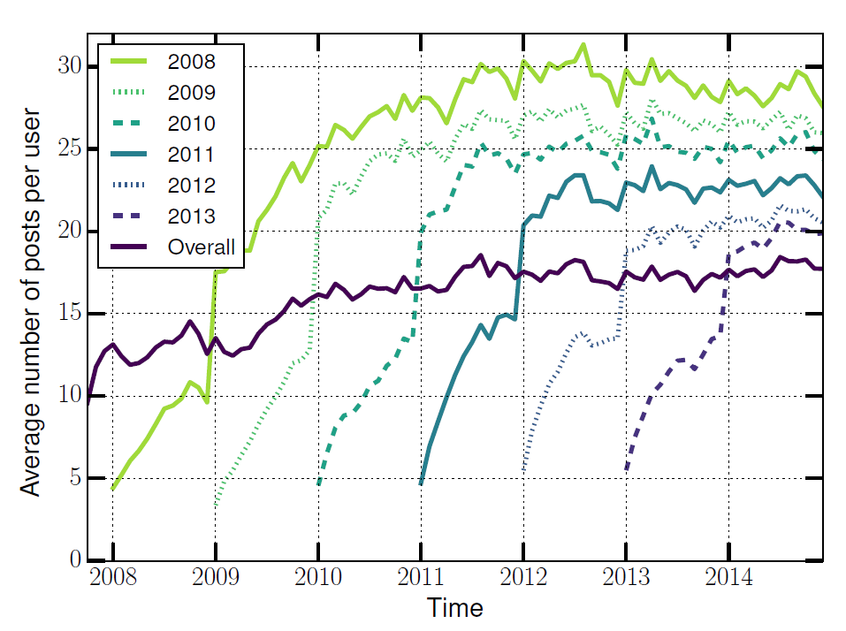
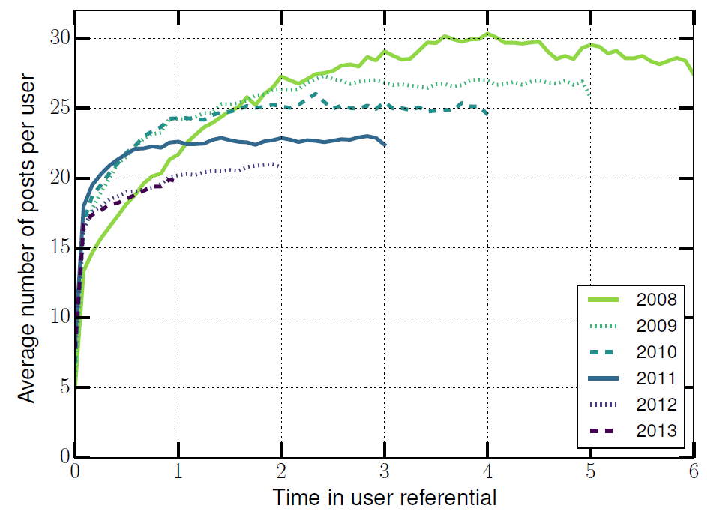
New cohorts do not catch up
User activity split by join date
… and aligned

Slide 32
Does tenure predict activity or vice versa?
Individual users come in with different motivations and posting propensities
The rise over time in activity is not that individual users become more active but that low-activity users leave the system

Slide 33
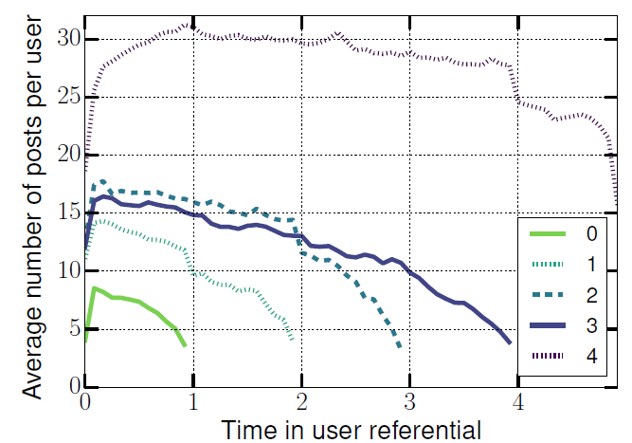
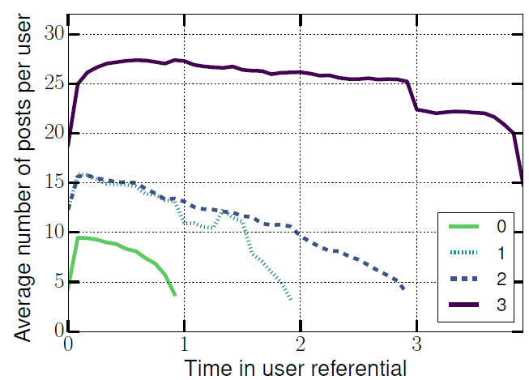
A cohort becomes less active over time
2010 cohort – low activity users more likely to leave
2011 cohort
Notes:
individual users come in with dierent posting propensities,
and the rise over time is not that individual users become
more active but that low-activity users leave the system
(H2).

Slide 34
Debiasing heterogeneous data
debiasing data to create more fair and generalizable models
disaggregate data into homogeneous groups
disaggregate data into similarly-behaving groups
remove correlations with a given feature

Slide 35
Central idea: Disaggregate data
Reduce bias by disaggregating data into homogeneous subgroups
Disaggregation tips
Ordinal variables: bin by value
E.g., disaggregate by department
E.g., disaggregate by year to create cohorts of users who joined in a given year
Continuous variables
Equal size bins? … some bins too sparse
Equal statistics bins? … some bins too heterogeneous
Data-driven binning

Slide 36
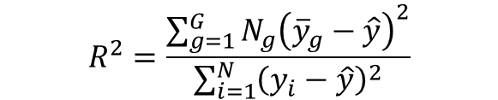
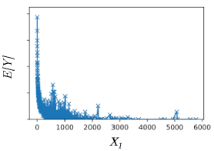
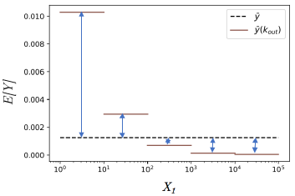
Data-driven binning
Split the data so as to maximize the amount of variation of the outcome variable Y the bins explain
Y
E[Y]
[Fennell, Zuo & Lerman (2019), “Predicting and Explaining Behavioral Data with S3D”, to appear in EPJ Data Science]

Slide 37
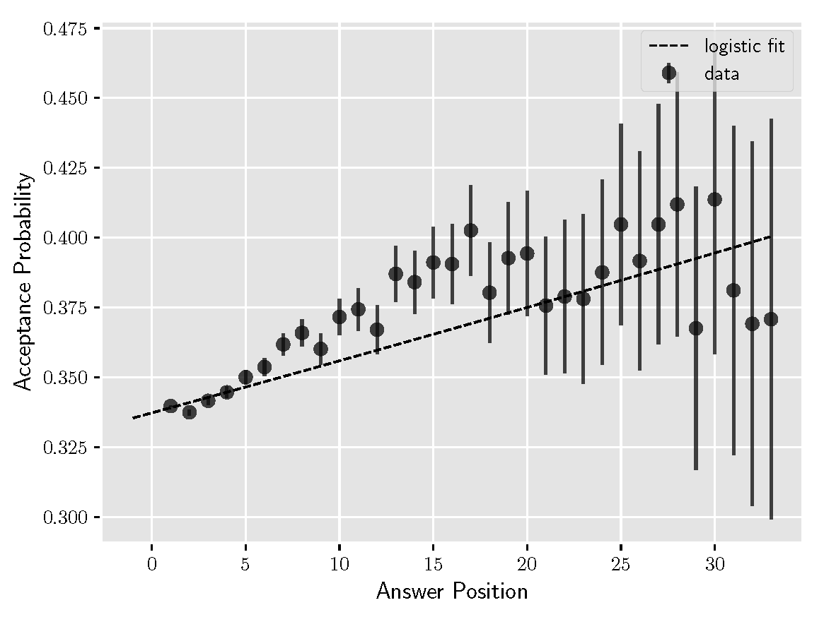
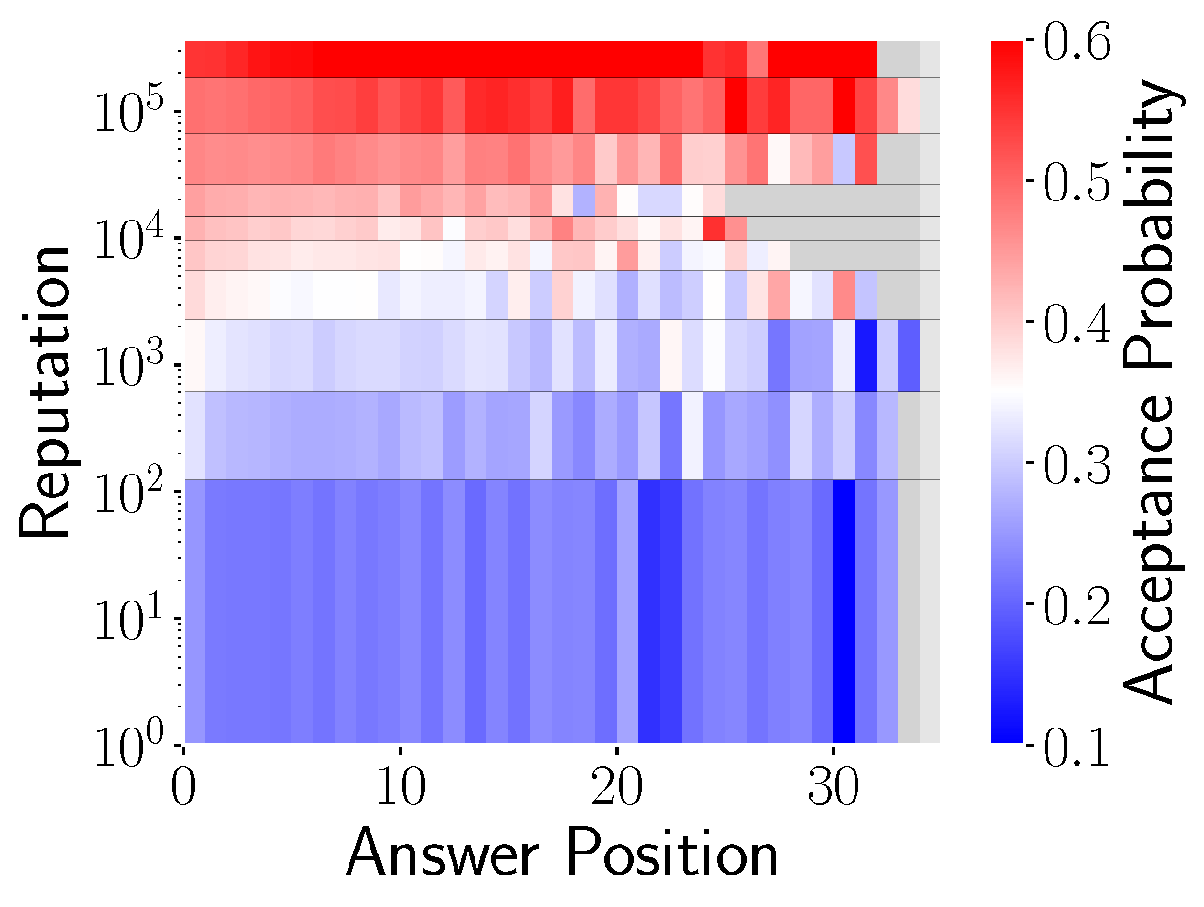
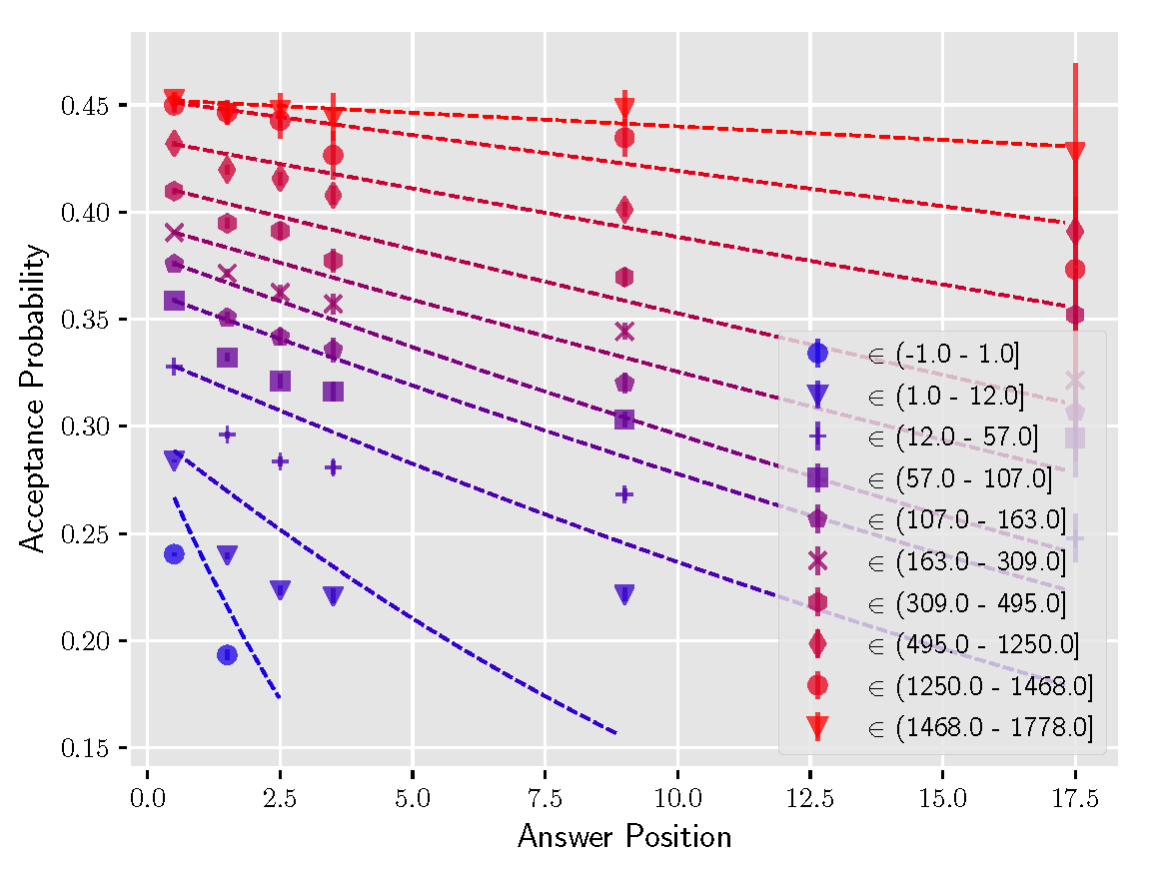
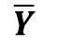
Disaggregate data by observed features
Disaggregate data by binning on observed features
Which features create Simpson’s paradox*
Estimate regression trends within a population
Disaggregate data by binning on an observed feature X_{c}
Compare trends in disaggregated data to those for the aggregated data
X_{c}
METHOD
X_{p}
X_{p}
X_{p}
Alipourfard, Fennell & Lerman (2018) Using Simpson’s paradox to discover interesting patterns in data. ICWSM. Code: https://github.com/ninoch/Trend-Simpsons-Paradox

Slide 38
Debiasing data via disaggregation
Disaggregate data on latent features to create more homogeneous groups
Joint disaggregation + regression (DoGR)*
Disaggregate data along multiple dimensions
Represent population with (latent) subgroups as a Gaussian Mixture Model
Estimate parameters via EM
Soft clustering
Regression within subgroups
Separate regression coefficients within each subgroup
Y
X₁
Y = a₁ X₁ + a₂ X₂ + a₃ X₃ + …
 | X₁ | X₂ | ...
Green | -1.2 | -0.6 | ...
Red | 2.6 | 1.2 | ...
Orange | -0.1 | 3.01 | ...
METHOD
Alipourfard, Burghardt & Lerman (2021) Disaggregation via Gaussian Regression for Robust Analysis of Heterogeneous Data. Handbook on CSS. Code: https://github.com/ninoch/DoGR

Slide 39

Illustration on Wine Data (UCI)
Groups
Red vs White wine
Outcome
Wine quality
Dimensions
Citric acid,
Chlorides,
Free Sulfur Dioxide (SO2),
Residual sugars,
…
data
 | outcome: quality | free SO2 | citric acid | residual sugars | …
White wines | 4898
Red wines | 1599
hide
groups

Slide 40
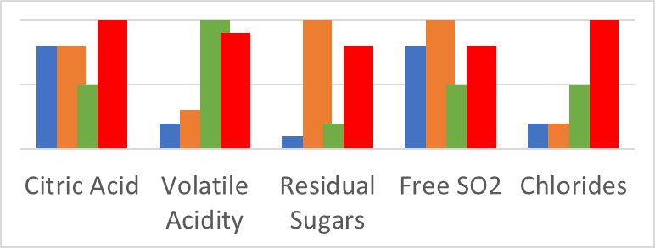
Latent subgroups in wine data
data
 | outcome: quality | free SO2 | citric acid | residual sugars | …
White wines | 4898
Red wines | 1599
Subgroup | Composition | Ave. quality
Blue | 98% white | 6.02
Orange | 100% white | 5.91
Green | 85% red | 5.60
Red | 57% red | 5.36
METHOD
Alipourfard, Burghardt & Lerman (2021) Disaggregation via Gaussian Regression for Robust Analysis of Heterogeneous Data. Handbook on CSS. Code: https://github.com/ninoch/DoGR

Slide 41
Latent subgroups in wine data
Subgroup regression: Simpson’s reversal!
 | Citric acid | Free SO2 | Residual sugar
 | β | β | β
All wines | 0.104 | -0.001 | -0.018
Subgroup
Blue | 0.430 | 0.017*** | 0.427***
Orange | -0.155** | -0.000 | -0.016
Green | -0.097 | -0.002 | 0.323***
Red | 0.304** | -0.011*** | -0.004***
Subgroup | Composition | Ave. quality
Blue | 98% white | 6.02
Orange | 100% white | 5.91
Green | 85% red | 5.60
Red | 57% red | 5.36
Higher sugars and quality
Higher citric acid and quality
METHOD
Alipourfard, Burghardt & Lerman (2021) Disaggregation via Gaussian Regression for Robust Analysis of Heterogeneous Data. Handbook on CSS. Code: https://github.com/ninoch/DoGR

Slide 42
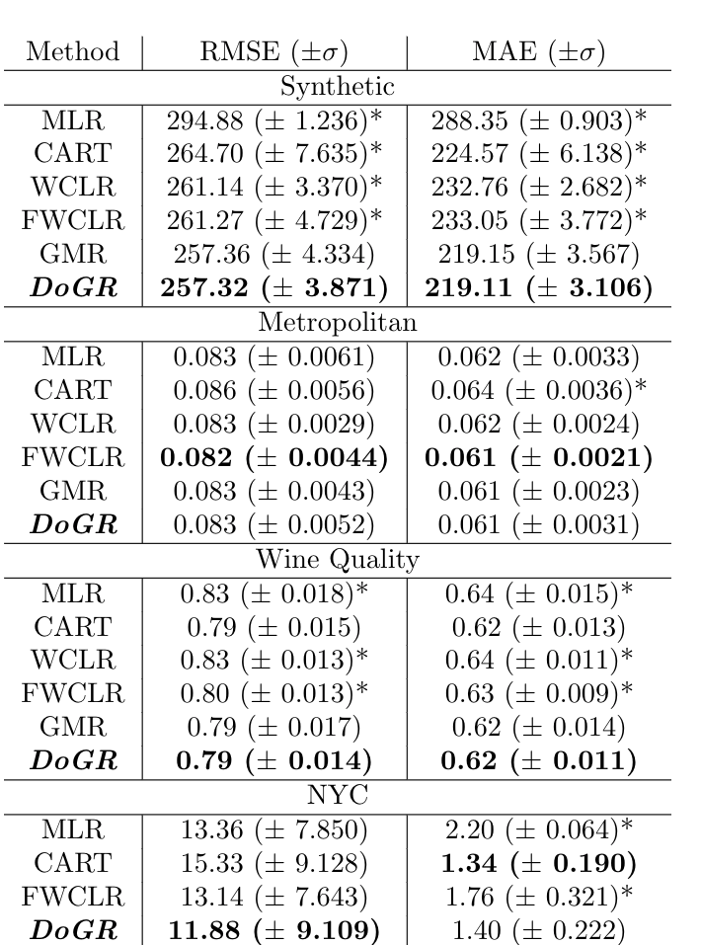
Evaluation
Prediction: 5x5-fold nested cross validation to train model, test on out-of-sample data.
Evaluation: Root Mean Square Error (RMSE) & Mean Absolute Error(MAE)
Without disaggregation
MLR: Multi-linear Regression
CART: Classification & Regression Trees
With disaggregation (better)
WCLR, FWCLR, GMR
DoGR

Slide 43
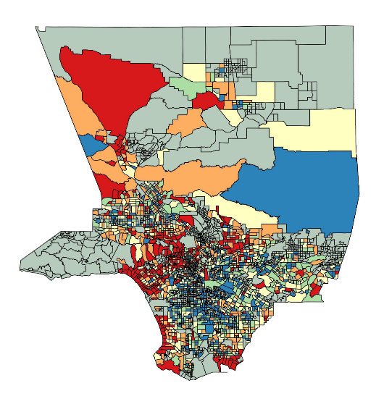
Happiness around LA County
Geolocated tweets linked to census tracts
Measure outcome: sentiment of tweets
Features
Whites,
Blacks,
Asians,
Hispanics,
Poverty (% below poverty)
Education (% graduate degree)
Sentiment (color: red=happy, blue=sad)

Slide 44
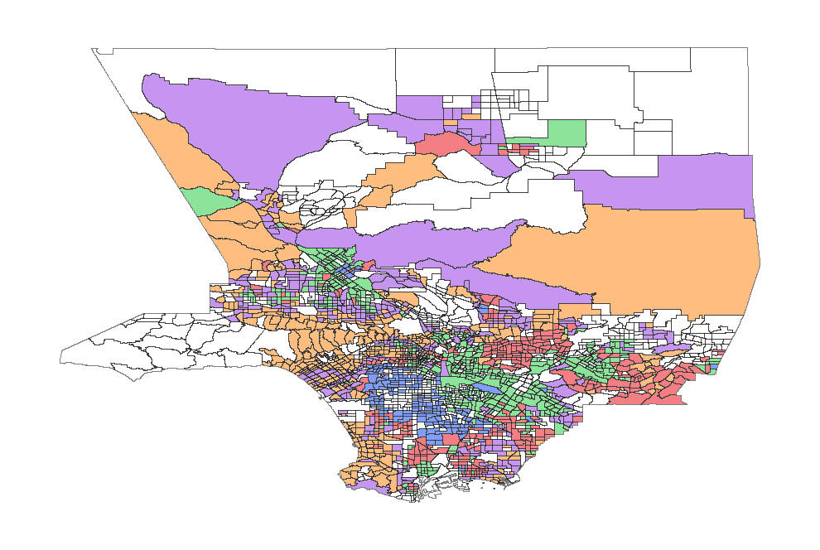
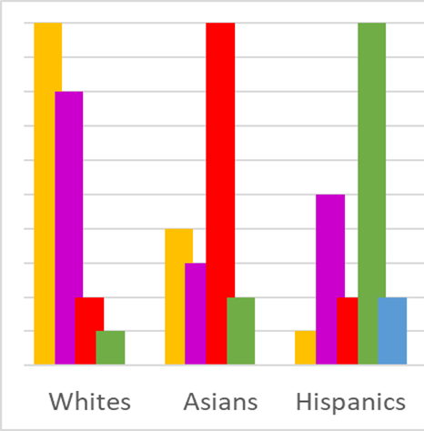
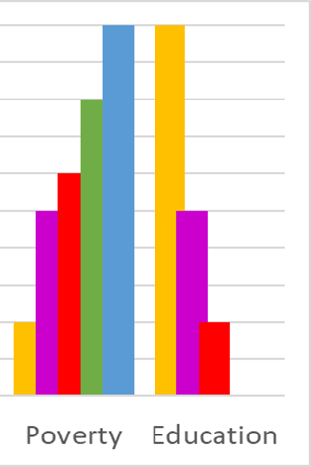
Latent subgroups of LA County
Subgroup | Ave. valence
Orange | 5.86
Purple | 5.80
Red | 5.76
Green | 5.74
Blue | 5.72

Slide 45
Lessons learned
Regardless of how many features are considered, individuals will differ along neglected dimensions. Some of these differences affect the individuals' chances of death, marriage, unemployment, or other transition.
Because of this heterogeneity, selection will occur: the surviving population will differ from the original population.
This means that observations of the surviving population cannot be directly translated into conclusions about the behavior of the individuals who made up the original population.
The observed dynamics at the population level will deviate from the underlying dynamics at the individual level.

Slide 46
Lessons learned
When is this not an issue? When the population is homogeneous.
In other cases, patterns observed over the population may be surprisingly different from the underlying patterns on the individual level
Researchers interested in uncovering these individual patterns – to help develop theories or to make predictions, might benefit from an understanding of heterogeneity.
When should a researcher suspect substantial heterogeneity? Always.

Slide 47
